Slide 1
Vigenere Cipher
Dr. Abhijit Sen

Slide 2
Substitution Cipher
A substitution cipher is one in which each letter of the plaintext is replaced by some other symbol.

Slide 3
Polyalphabetic Cipher
A Polyalphabetic Cipher is a substitution cipher is one in which each letter of the plaintext character is replaced by more than one ciphertext character and each ciphertext character is replaced by more than one plaintext character.

Slide 4
Vigènere Cipher: Example
Message THE BOY HAS THE BALL
Key VIG
Encryption:
  Key VIG VIG VIG VIG VIG V
  plain THE BOY HAS THE BALL
  cipher OPKWWECIYOPKWIRG

Slide 5
Vigènere Cipher: Encipher?
We begin by writing the keyword, repeated as many times as necessary, above the plaintext message. To derive the cipher text using the tableau, for each letter in the plaintext, one finds the intersection of the row given by the corresponding keyword letter and the column given by the plaintext letter itself to pick out the cipher text letter.

Slide 6
Vigènere Cipher: Example
V | I | G | V | I | G | V | I | G | V | I | G | V | I | G | V
T | H | E | B | O | Y | H | A | S | T | H | E | B | A | L | L
O | P | K | W | W | E | C | I | Y | O | P | K | W | I | R | G

Slide 7
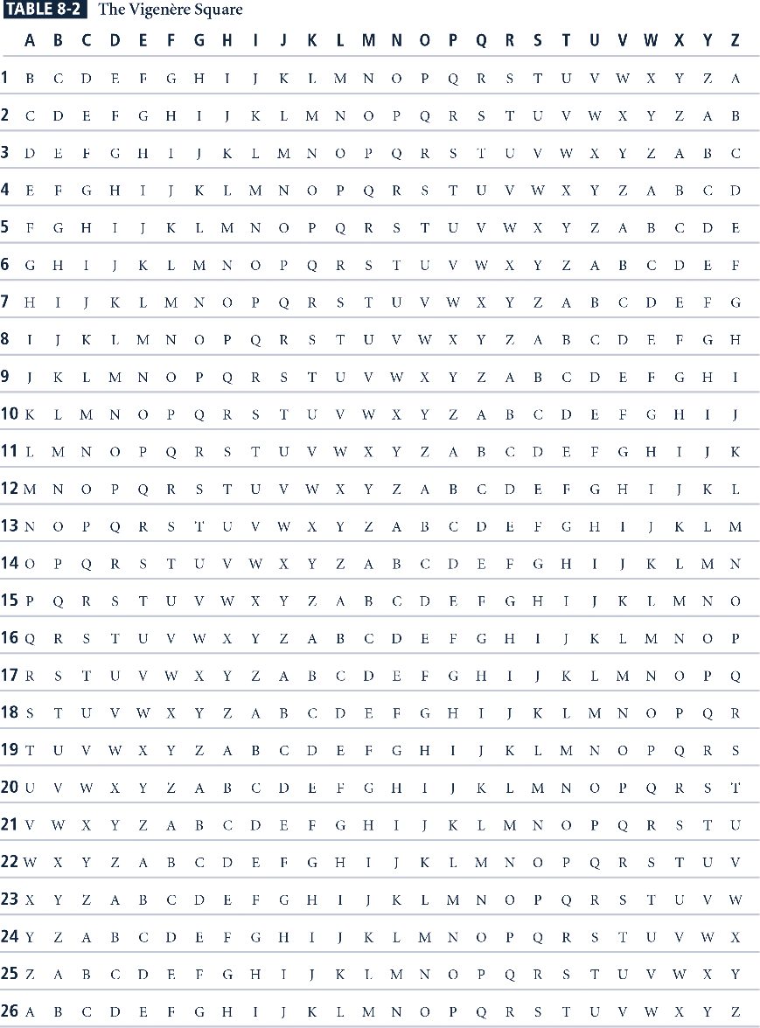
Vigènere Square

Slide 8
Relevant Parts of Tableau
G I V
A G I V
B H J W
E K M Z
H N P C
L R T G
O U W J
S Y A N
T Z B O
Y E H T
Tableau shown has relevant rows, columns only
Example encipherments:
  key V, letter T: follow V column down to T row (giving “O”)
  Key I, letter H: follow I column down to H row (giving “P”)

Slide 9
Vigènere Cipher: Decipher?
Decipherment of an encrypted message is equally straightforward. One writes the keyword repeatedly above the message.
  This time one uses the keyword letter to pick a column of the table and then traces down the column to the row containing the ciphertext letter. The index of that row is the plaintext letter.

Slide 10
Vigènere Cipher: Example
V | I | G | V | I | G | V | I | G | V | I | G | V | I | G | V
O | P | K | W | W | E | C | I | Y | O | P | K | W | I | R | G
T | H | E | B | O | Y | H | A | S | T | H | E | B | A | L | L

Slide 11
Relevant Parts of Tableau
G I V
A G I V
B H J W
E K M Z
H N P C
L R T G
O U W J
S Y A N
T Z B O
Y E H T
Tableau shown has relevant rows, columns only
Example encipherments:
  key V, letter T: follow V column down to T row (giving “O”)
  Key I, letter H: follow I column down to H row (giving “P”)

Slide 12
Polyalphabetic Substitution
A polyalphabetic substitution cipher involves the use of two or more cipher alphabets. Instead of there being a one-to-one relationship between each letter and its substitute, there is a one-to-many relationship between each letter and its substitutes.
  H has P or C as substitutes in our example

Slide 13
Polyalphabetic Substitution
Each letter of our keyword VIG picks out 1 of the 26 possible substitution alphabets given in the Vigenere tableau. Thus, any message encrypted by a Vigenere cipher is a collection of as many simple substitution ciphers as there are letters in the keyword.

Slide 14
Polyalphabetic Substitution
The Vigenere Cipher , proposed by Blaise de Vigenere from the court of Henry III of France in the sixteenth century, is a polyalphabetic substitution based on the shown tableau .

